Slide 1
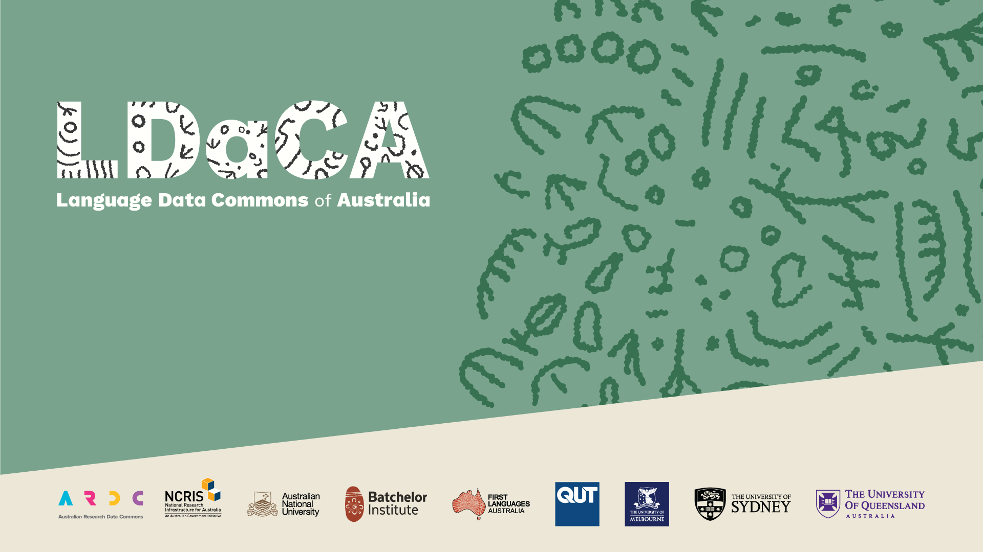
A new approach to Machine Actionable Schemas for linked-data, simplifying schema and profile development for metadata systems
Rosanna Smith
Peter (PT) Sefton
Notes:
The Research Object Crate (RO-Crate: https://www.researchobject.org/ro-crate/) specification is now widely used for interchanging Research (data) Objects (ROs), and has been used as the basis for several projects in the Australian Research Data Commons (ARDC) Humanities and Social Sciences & Indigenous Research Data Commons (HASS&I RDC). RO-Crates are based on linked-data and offer a simple, easy-to-implement way of packaging data for interoperability in line with the FAIR principles. They offer a consistency for deposit in repositories, and re-use in analytical pipelines and as the basis for web sites. Until now the RO-Crate community has lacked a similarly simple approach to validating ROs for consistency, or configuring editing environments and other tools used to produce data packages. In this presentation we show a new approach to describing general purpose linked data schemas and specific data profiles for particular domains and systems known as RO-Crate Machine Actionable Schemas and Profiles (MASP), using examples ranging from Indigenous Knowledge systems, to describing research software implemented, all in line with World Wide Web Consortium standards for metadata profiles. We will show easy-to-use tools, and show how schemas and profiles can be maintained using easy-to-understand spreadsheets. RO-Crate MASP tooling includes generating human-readable documentation, a validator and a compatible RO-Crate editor (Crate-O).

Slide 2

What is LDaCA
Making nationally significant language data available
for use by researchers and communities.
Providing a model for ensuring continued access with appropriate community control.
Showcasing Australia’s linguistic diversity Australia is a massively multilingual society with the world’s oldest continuous cultures situated in one of the most linguistically diverse regions in the world
Securing language data
Large collections of language data have been amassed in Australia, but many remain under-utilised or at risk
Computational analysis
Growing demand for text analytics capability and computational methods
Notes:
This work came of the LDaCA project but what we’re talking about today is a general-purpose approach to linked data.

Slide 3








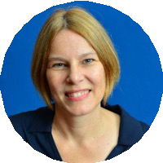




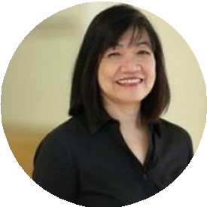


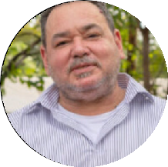
2024-2028 Project collaborators
Rose Barrowcliffe University of Queensland / Macquarie University
Michael Haugh
University of Queensland
Catherine Travis
ANU
Monika Bednarek
University of Sydney
Martin Schweinberger
University of Queensland
First Languages Australia
Jenny Fewster and team
ARDC
Marissa Takahashi QUT Australian Digital Observatory
Curtis Roman
Batchelor Institute
Nick Thieberger
University of Melbourne
Notes:
LDaCA has a range of collaborators across several universities and institutes.

Slide 4
LANGUAGE DATA CHALLENGES
Collect & Organise
Language data is rarely organised or described in reusable ways, if it’s described at all
Preserve
A lot of language data is at risk of being lost forever
Find
It’s difficult to know what language data exists and where to find it
Access
Processes for granting permissions and getting access to data are either absent or aren’t easy to understand or apply
Analyse
Ad hoc tools, analysis and annotation methods are used, hampering reproducibility
Guides for collecting, handling and using data are scattered and hard to find
Guide
Notes:
Linked data helps us meet all of the challenges for language data highlighted above, from collecting and organising data to analysing it.
In the two decades since Tim Berners Lee’s publication on Linked Data principles, adopting the principles has been hard and involves specialised tooling that has not been particularly mainstream.
At LDaCA, we’re working with linked data through the use of RO-Crate or Research Object Crate, and this approach helps address the language data challenges shown here.

Slide 5

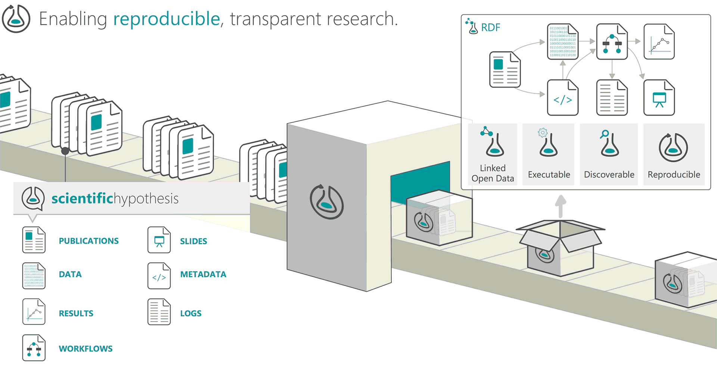
WHAT IS RO-CRATE?
RO-Crate is a spec for packaging and describing linked data.
Linked data is an extensible metadata format that uses URLs so everything is documented.
Accessible, usable approach to linked data.
Notes:
RO-Crate is an open Linked Data based specification, for packaging, storing and interchanging data (and is thus aligned with the goals of LDaCA and other Data Commons projects).
RO-Crate was designed from the start to be accessible to developers who are not linked-data aware, using the JSON-LD (or Linked Data) variant of JSON for encoding metadata descriptions, rather than XML (which is dated and has patchy support) or more esoteric RDF (or Resource Description Framework) encodings.
We won’t go into huge detail on RO-Crate this talk, but will focus on how the semantics of RO-Crates can be formalised using Schemas and Profiles.

Slide 6
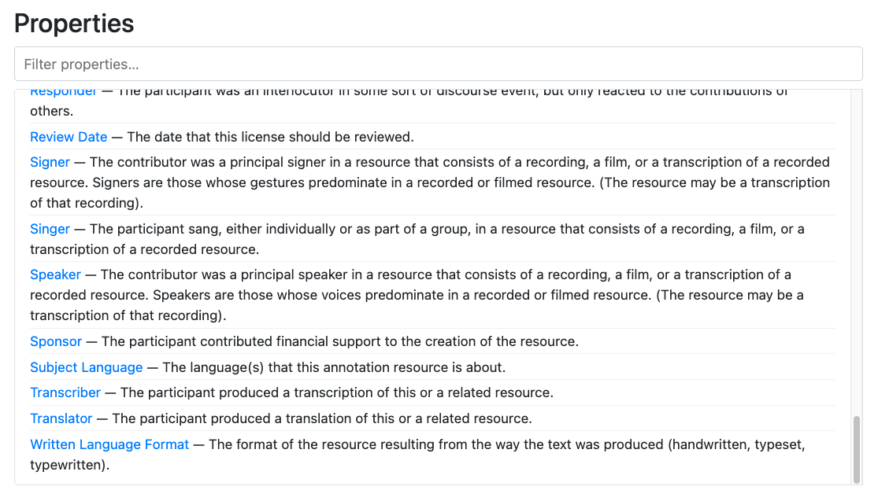
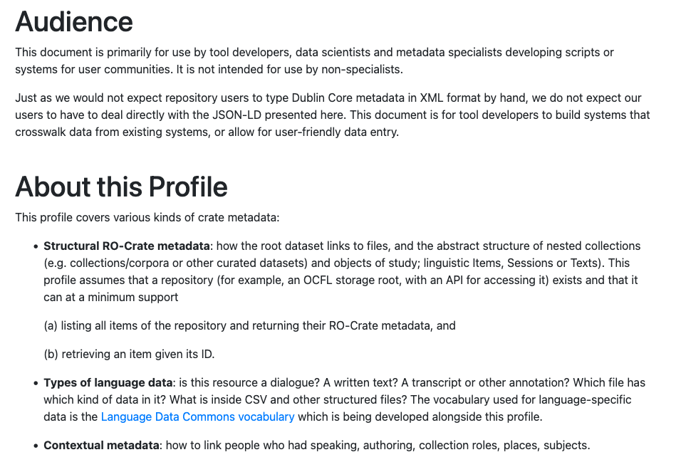
SCHEMAS & PROFILES
Schemas specify a metadata vocabulary of classes, properties and other terms, and may include additional specifications and requirements for particular terms.
Profiles describe how a schema is applied to a particular domain or use case, and can take metadata from multiple schemas. They are prose documents that provide more guidance on structuring collections, required metadata, access protocols and other additional details.
Notes:
The frameworks we use for metadata come under schemas and profiles.
Schemas are how metadata is structured and standardised at the highest level. They can specify requirements for metadata fields, e.g. date published must have a date format value.
Different disciplines can have different standards as well.

Slide 7
schema.org
Dublin Core
Darwin Core
general
LDAC
Danala / top end schema
XYZ
SCHEMAS
groups of properties
Batchelor
ARDS
specific
LDaCA
ARDS
Batchelor
PROFILES
collections of properties from different schemas
Schemas and profiles can be published, publicly or privately, and can have terms and conditions, and licences for how they can be used/shared.
Notes:
Schemas can range from very general like schema.org and Dublin Core, to more specific like LDAC which focuses on language-related metadata, and private schemas like ARDS which describes clan and kinship terms for example.
Profiles are subsets of standards and are more tailored to specific use cases, for example, the profile used by LDaCA is designed specifically to provide guidance on how to structure and describe language collections.
The LDAC profile uses schema.org and parts of Dublin Core as its foundation for metadata, but it also pulls from the LDAC schema for terms specific to describing language data.
Profiles also provide guidance on structuring collections, required metadata, access protocols and additional details about the metadata, for example, terms intended to describe a file as opposed to a person.
Whereas schemas focus on defining the metadata terms and their individual requirements, profiles provide more overall context for how the metadata should be used and guidance on structuring particular collections.
Profiles also have the ability to take metadata from various schemas and codify that for use with particular types of datasets.

Slide 8


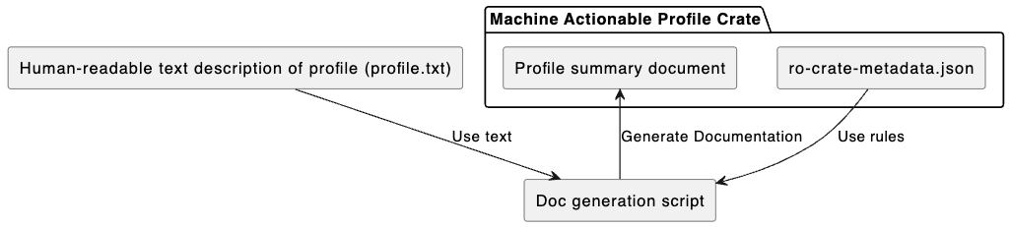
MASP DETAILS
Machine Actionable Schemas and Profiles - generates schema and profile documentation.
github.com/Language-Research-Technology/ro-crate-masp
Applicable to a wide range of metadata description, e.g. LDaCA, ARDS Aboriginal Corporation, Batchelor Institute.
Can be used in combination with textual summary of the Profile to create documentation with an automatically generated summary of what should be in conformant crates.
Notes:
The next stage in development of schemas and profiles is RO-Crate MASP, which stands for machine actionable schemas and profiles.
Previously, schemas and profiles have been created separately with scripts for generating the documentation specific to a single profile or schema, but MASP brings these together so the same scripts can be used to generate multiple documents.
This approach is currently being used for the LDAC schema for language data, as well as the schemas of ARDS Aboriginal Corporation and Batchelor Institute, both of which are closely developed with knowledge holders to describe clan and kinship terms that reflect ancient and ongoing cultural knowledge systems.
The diagram here shows how a profile is generated - it takes a JSON file of the metadata terms used in the profile which can be adapted from schemas, as well as a human-readable text file that provides more guidance and description of the profile. These two files are used by the script to generate the profile document, and that document and the JSON file become the profile crate.

Slide 9
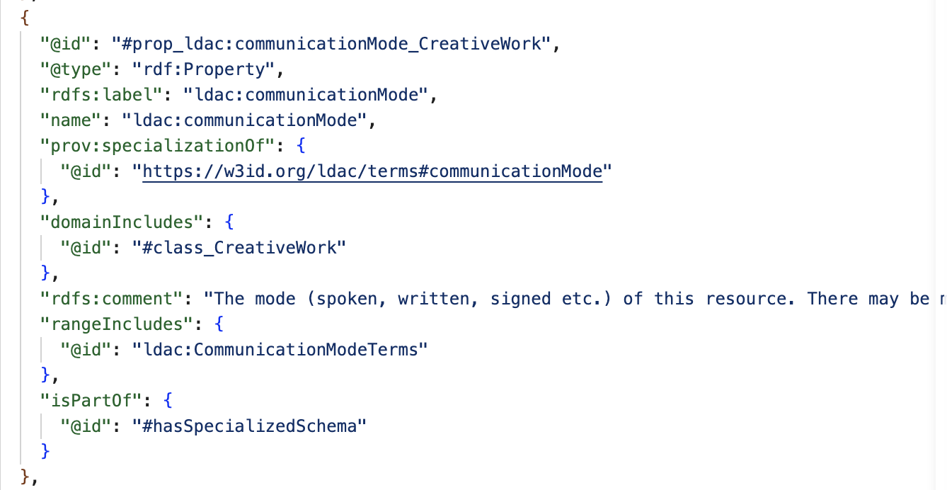
Notes:
This slide shows what a MASP profile component looks like “under the bonnet”. It’s JSON-LD. This is defining a property “communicationMode” which is defined in the Language Data Commons Schema. It occurs in the domain of any schema:CreativeWork, and the value it points to is one of a set of CommunicationModeTerms.

Slide 10
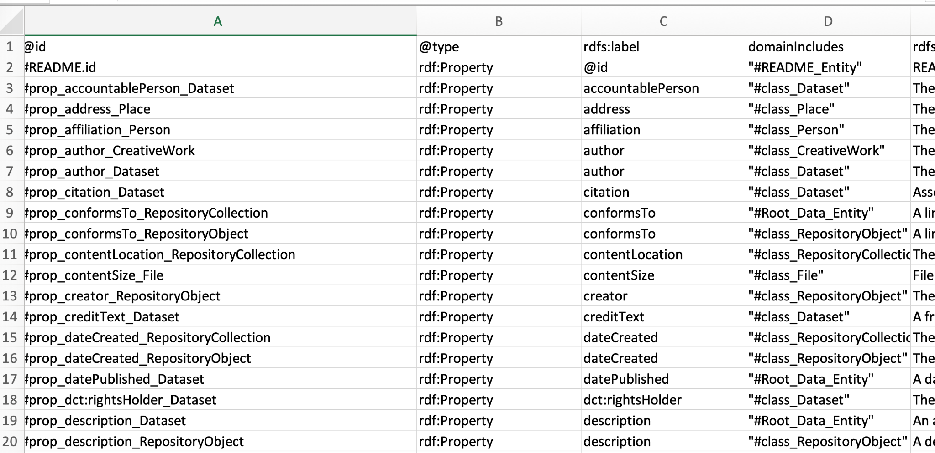
Notes:
This slide is a screenshot of the same property definition in an Excel format – it is possible to edit in either the text file or a spreadsheet, or in an RO-Crate editor.

Slide 11
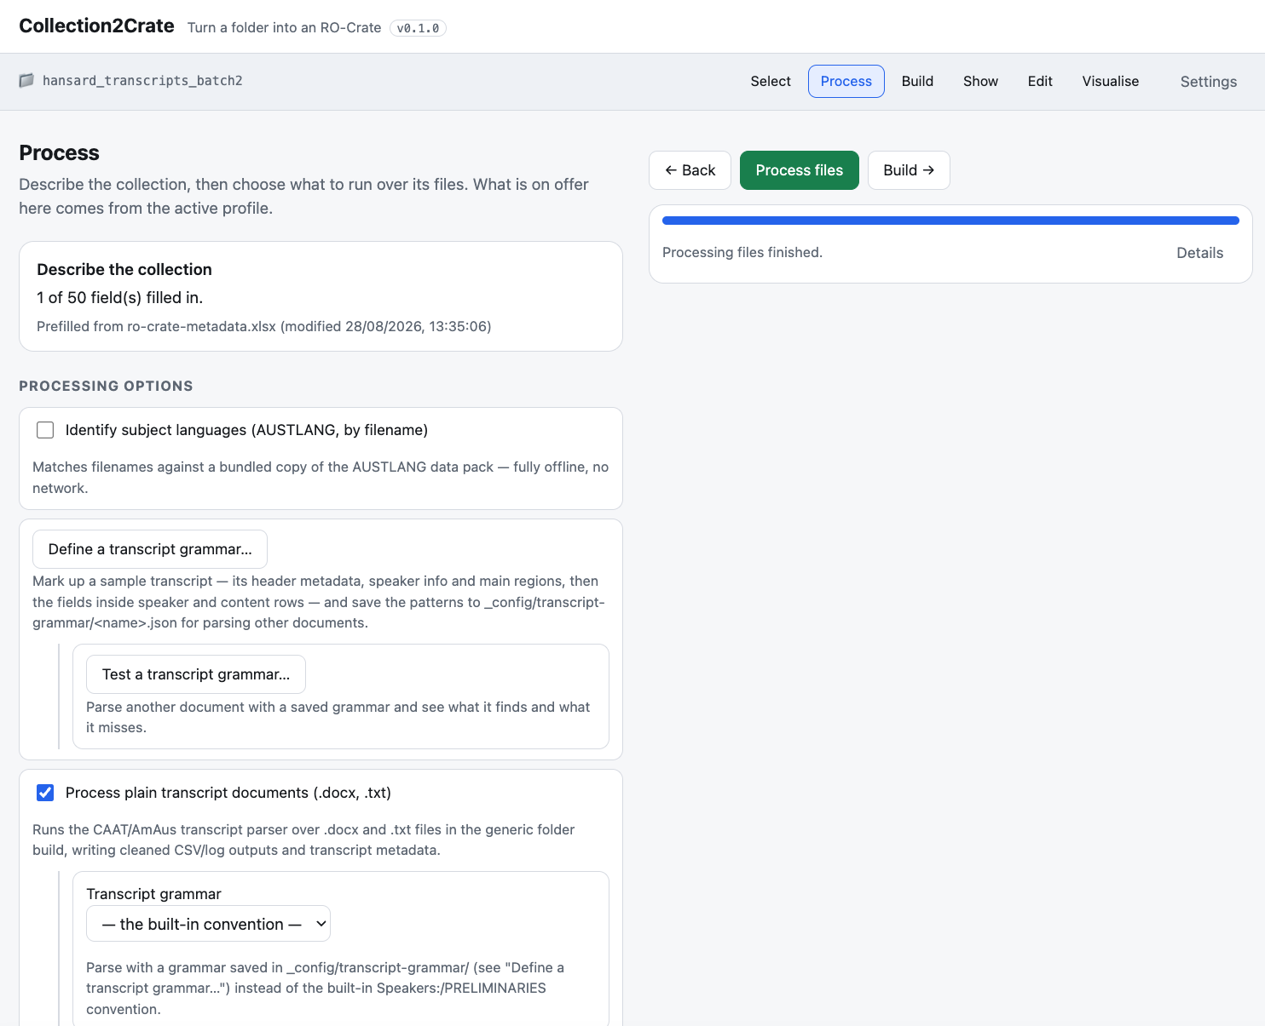
APPLIED MASP: MASP-DRIVEN EDITORS & TOOLS
In development:
MASP profiles used to configure Collection2Crate (C2C).
Plugins and options available according to each profile's tool-config.
Allows users to select the processing options they want to work with for their collection that are available for the matching profile, e.g. LDAC profile provides AustLang lookup, conversation transcript processing, CHAT (.cha) output generation.
Notes:
One of the other major uses for MASP that we’re currently working on is to drive tools for managing collections.
An example of this is Collection2Crate or C2C, which is a browser tool that turns a folder of files on your computer into an RO-Crate, with optional data cleaning, processing and visualisation steps.
It’s built for people organising diverse collections of files who need consistent, publishable metadata without having to become RO-Crate experts themselves.
Depending on which MASP profile you select, this will determine which fields you can use to describe your collection, which plugins are available for processing the data, what gets written out, and what counts as a valid RO-Crate.
In the screenshot, the processing options available here are those configured for the LDAC profile for language data, so selecting another profile would change the options we see in this and other sections of C2C.

Slide 12
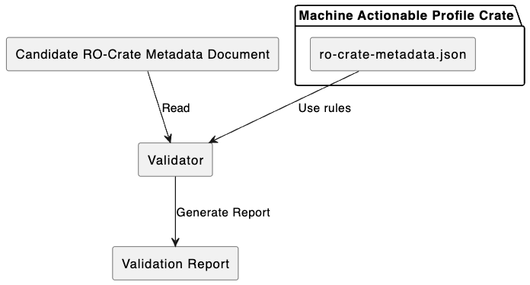
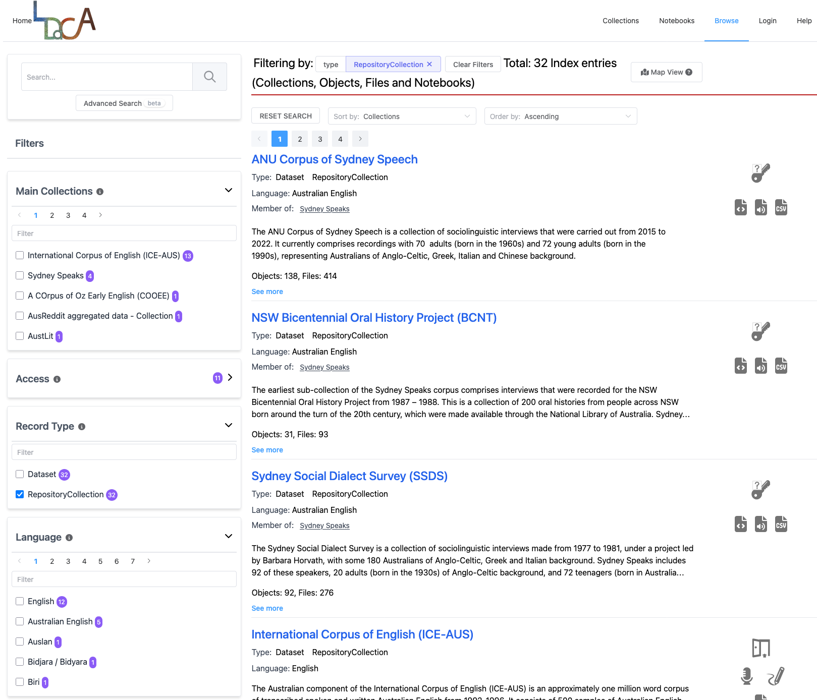
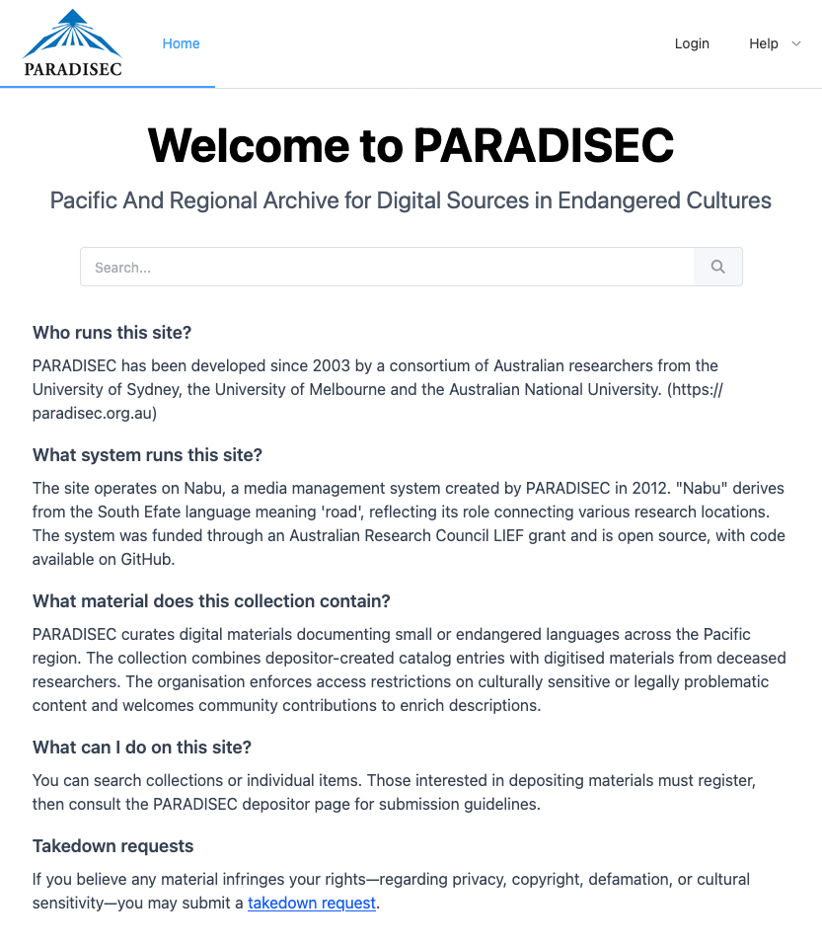

APPLIED MASP: VALIDATING COLLECTIONS
data.ldaca.edu.au
catalog.paradisec.org.au
Notes:
MASP profiles can also be used to validate collections for deposit into repositories.
The diagram shows how the JSON file in a profile crate can be used as a set of rules to validate a collection that uses this profile, meaning that any missing required metadata, errors in how the collection has been structured, and other requirements can be flagged and corrected.
Both PARADISEC, or the Pacific and Regional Archive for Digital Sources in Endangered Cultures, and LDaCA share the LDAC profile for language data, and this validation method is used for collections deposited into the Language Data Commons Portal.

Slide 13
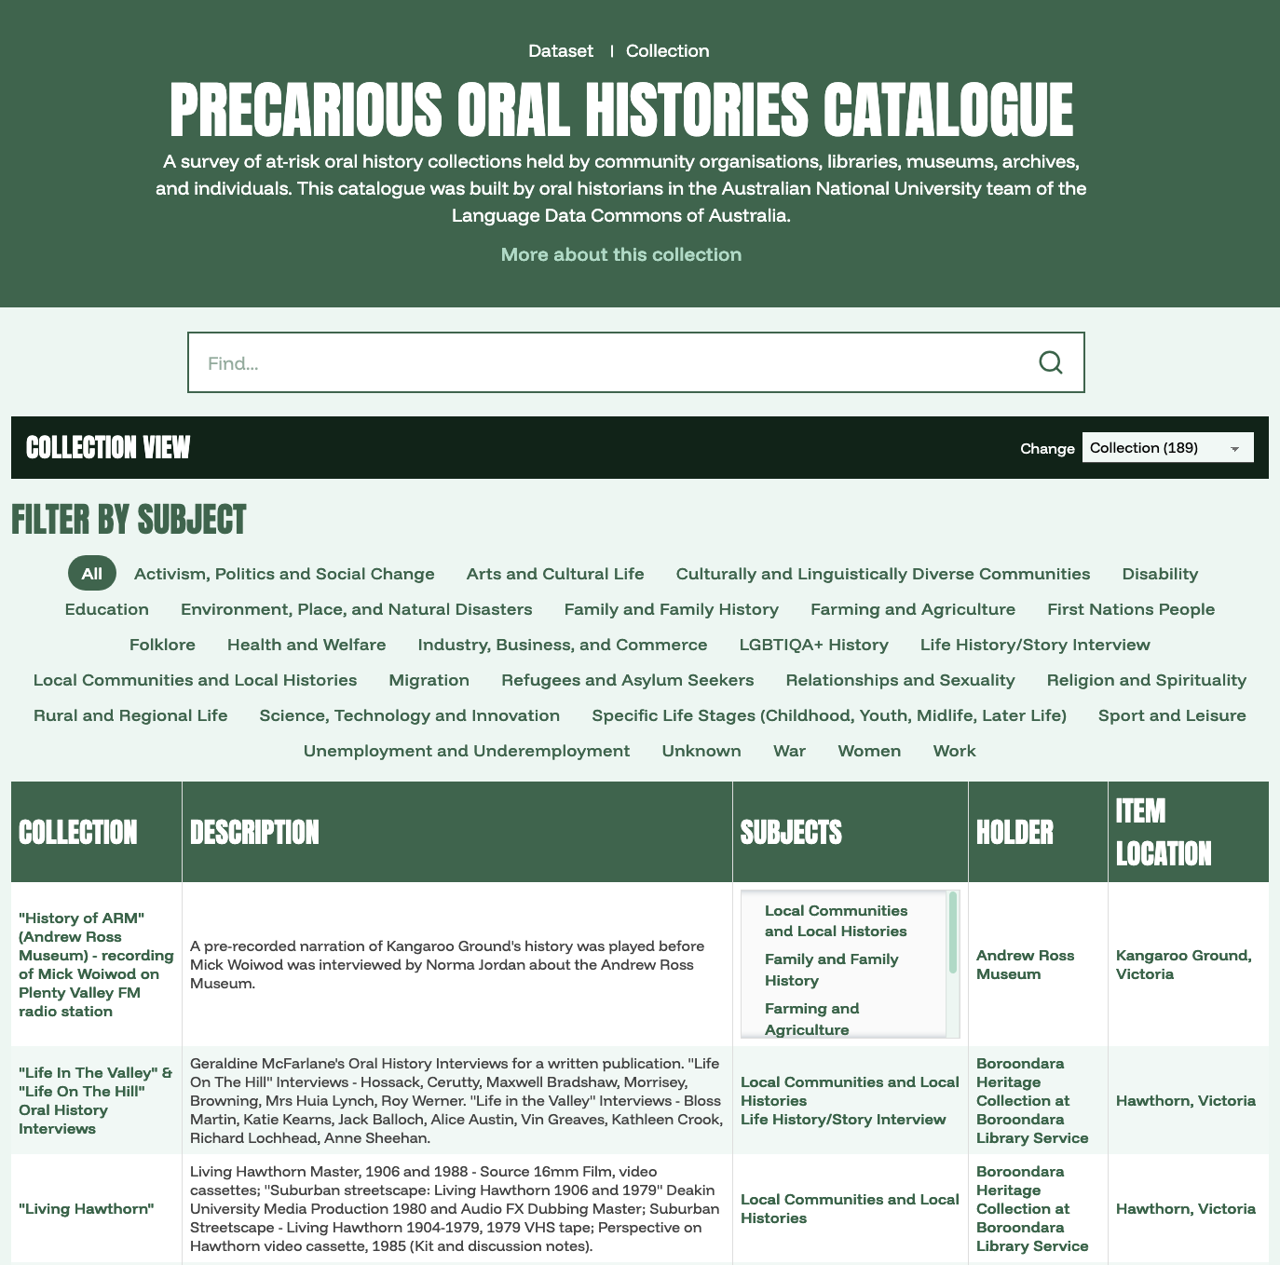
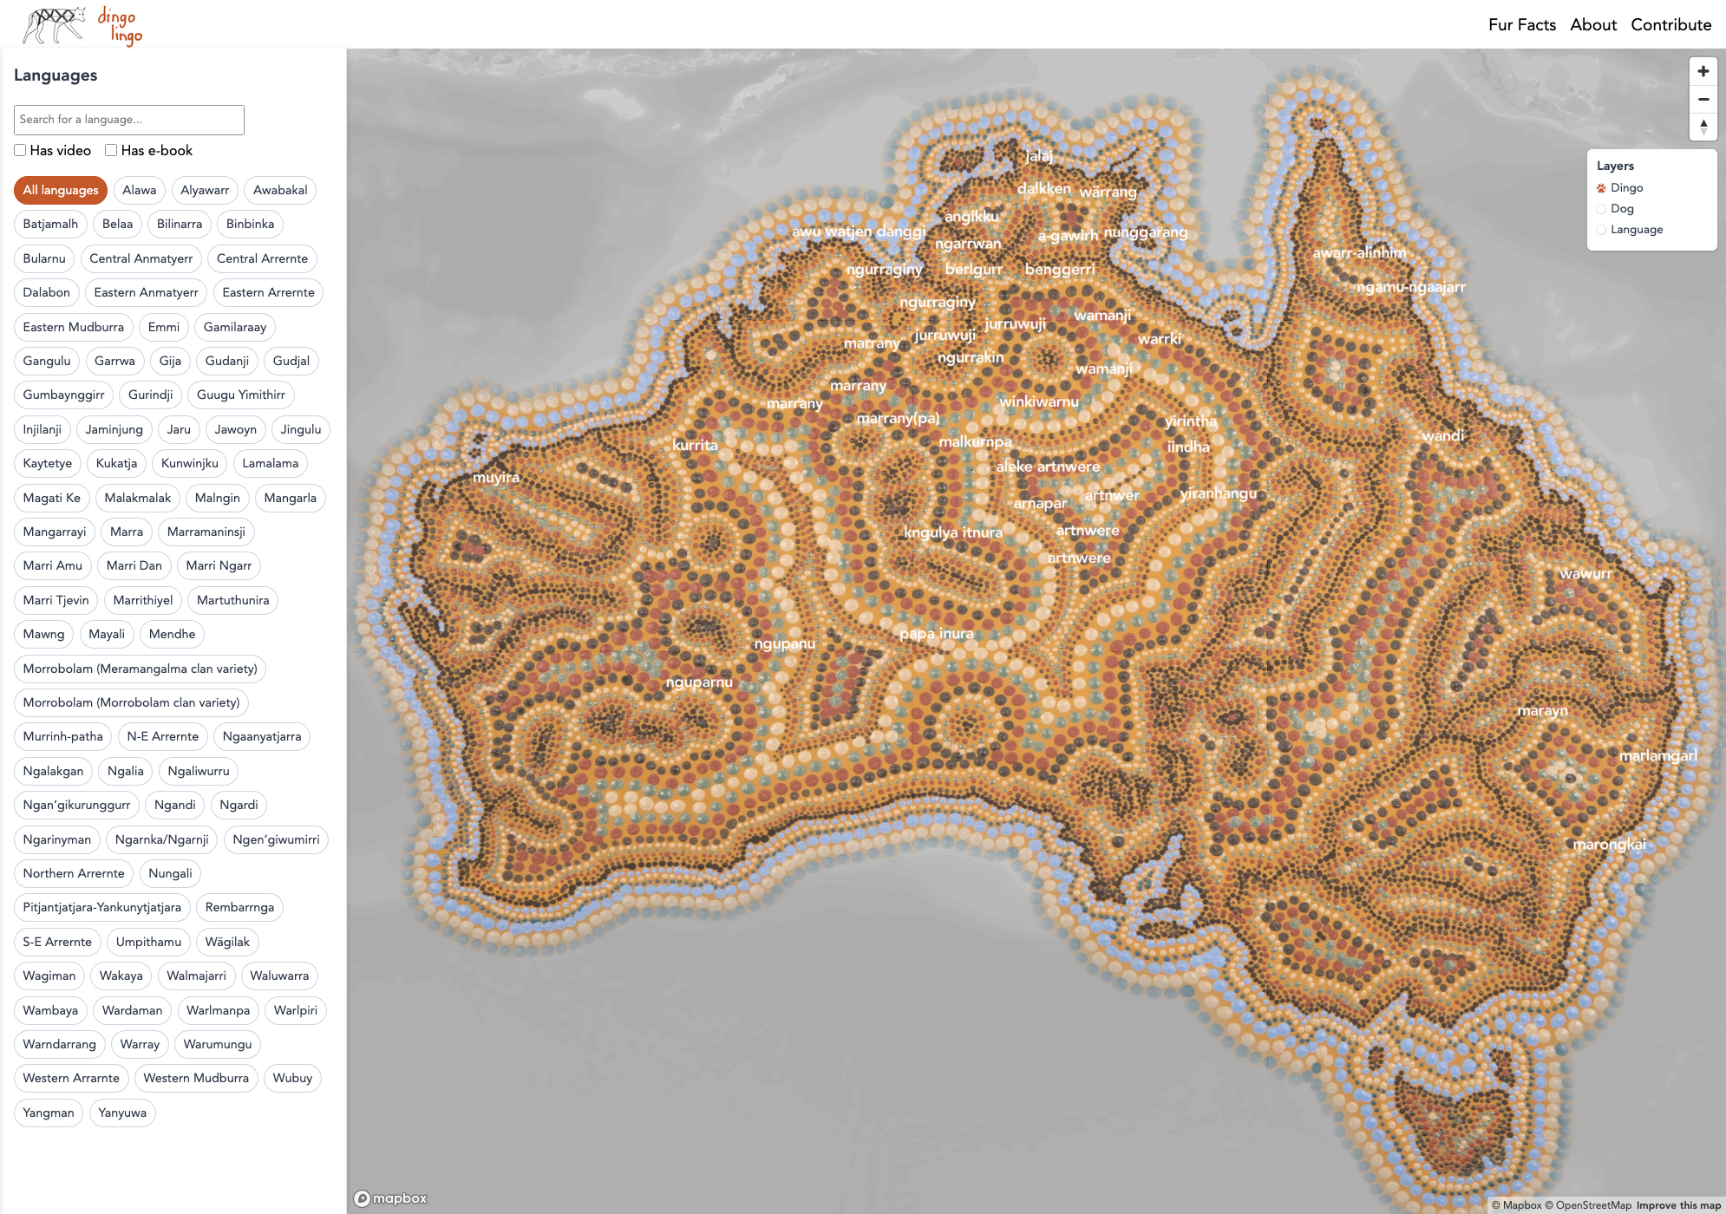
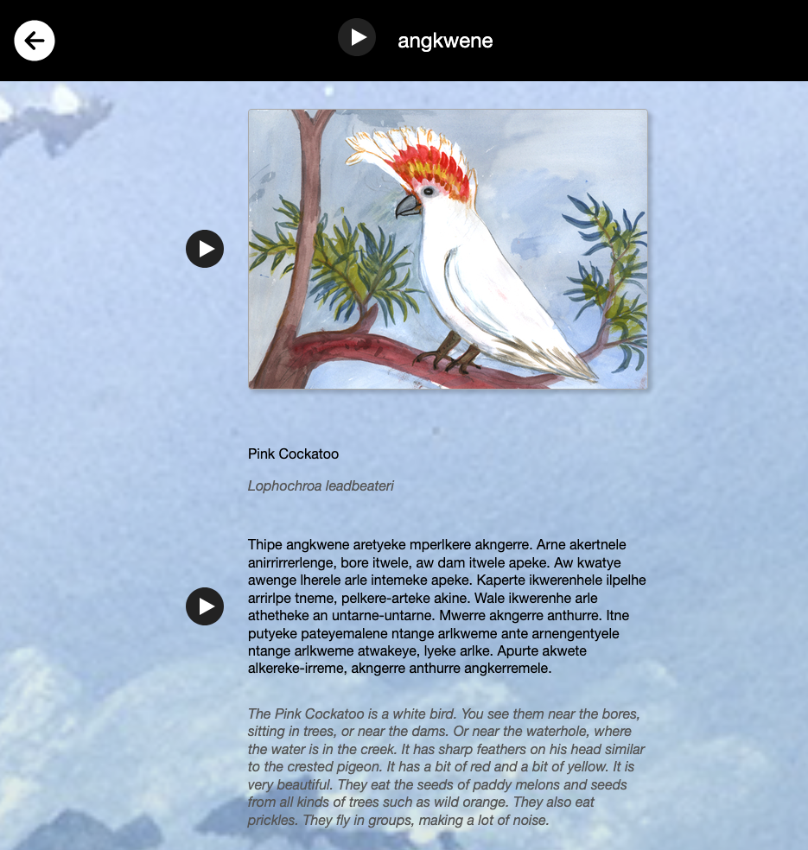
APPLIED MASP: PROFILE-SPECIFIC HTML TEMPLATES
dingolingo.au
precariousoralhistories.com/project-database
Created with: github.com/crate-works/ro-crate-static-site
ayeye-thipe-akerte.bird-apps.com
Notes:
Another way MASP can be used is to indicate, or potentially package HTML templates that configure the design and layout of static sites for RO-Crated collections.
This method uses the ro-crate-static-site generator which takes an RO-Crate and provides a static HTML site configured according to that collection.
We can extend this further so that individual MASP profiles provide a set of templates available for collections using this profile, and these can then be further configured according to the requirements of the particular collection.
Several examples already using this method are Precarious Oral Histories, which catalogues at-risk oral history collections throughout Australia, the Arrernte Bird Stories, providing names, calls and descriptions of birds in language, and Dingo Lingo, which maps words for dingoes and dogs across Australia in Indigenous languages.
Each of these collections requires unique ways of presenting the information, including search, filtering, tabulation, geographical mapping, and audio and visual media.
The static site approach, coupled with MASP profiles, allows for these unique requirements, so that while each of these sites uses the same static site generator, the configuration of each can be determined by the profile.

Slide 14
MASP: COMPLETE LINKED DATA ENVIRONMENT
Data Preparation
Organise folders of data
MASP-driven organisation
Cleaning tools
Add derived files
Migrate format
Transcribe
Annotate
Aggregate
Describe & Package
MASP-driven metadata entry
MASP tool “activation”
Analysis
Notebooks
Code libraries
Visualisations
Computational workflows
Applications
RO-Crate
Data Packages
Deposit & Display
Repository deposit
Static websites
Portable data appliances
MASP Validation
Notes:
This diagram shows the “narrow waist” of standardisation – on the left is data preparation which is focussed on organising and describing data for two main purposes:
1. Deposit into archival repository services where it can be found,
2. Analysis; by which we mean pretty much any research process that uses the data to gain some insight. If data has been organised to a metadata profile, then systems such as C2C can turn on access to tools that work with data conforming to that profile.
Schemas:
- Provide shared terms for findability and data interoperability
- Provide guidance on structuring data
- Ensure that metadata terms are documented (by following the links to the schema)
Profiles:
- Set expectations for what can be put into an archival repository in detail (and how schema terms can be combined)
- Can have packaged resources such as display templates and pointers to data preparation tools like C2C

Slide 15
DATA RE-USE OF MASP-VALIDATED PACKAGES
Data Preparation
Organise folders of data
MASP-driven organisation
Cleaning tools
Add derived files
Migrate format
Transcribe
Annotate
Aggregate
Describe & Package
MASP-driven metadata entry
Analysis
Notebooks
Code libraries
Visualisations
Computational workflows
Applications
RO-Crate
Data Packages
Deposit & Display
Repository deposit
Notes:
This MASP workflow also lends itself to reuse of RO-Crated data collections with the same analysis tools for greater interoperability.
Since all deposited collections already meet the MASP validation requirements, they will function with a range of ready-to-use notebooks, libraries, visualisations, workflows and apps, meaning that the same methods and tools can be applied to multiple collections.

Slide 16
MASP: RESEARCH OUTPUTS PUBLISHED/ARCHIVED
Data Preparation
Describe & Package
MASP-driven metadata entry
*Provenance information automatically included by tools
Analysis
Notebooks
Code libraries
Visualisations
Computational workflows
Applications
RO-Crate
Data Packages
Deposit & Display
Repository deposit
Notes:
Following on from this, research outputs from any analysis done on RO-Crated collections can also be put through the data preparation workflow and published or archived as their own RO-Crate collections.
This workflow automatically adds provenance information in the RO-Crate, making it clear exactly what tools and parameters were used to create individual research outputs.

Slide 17
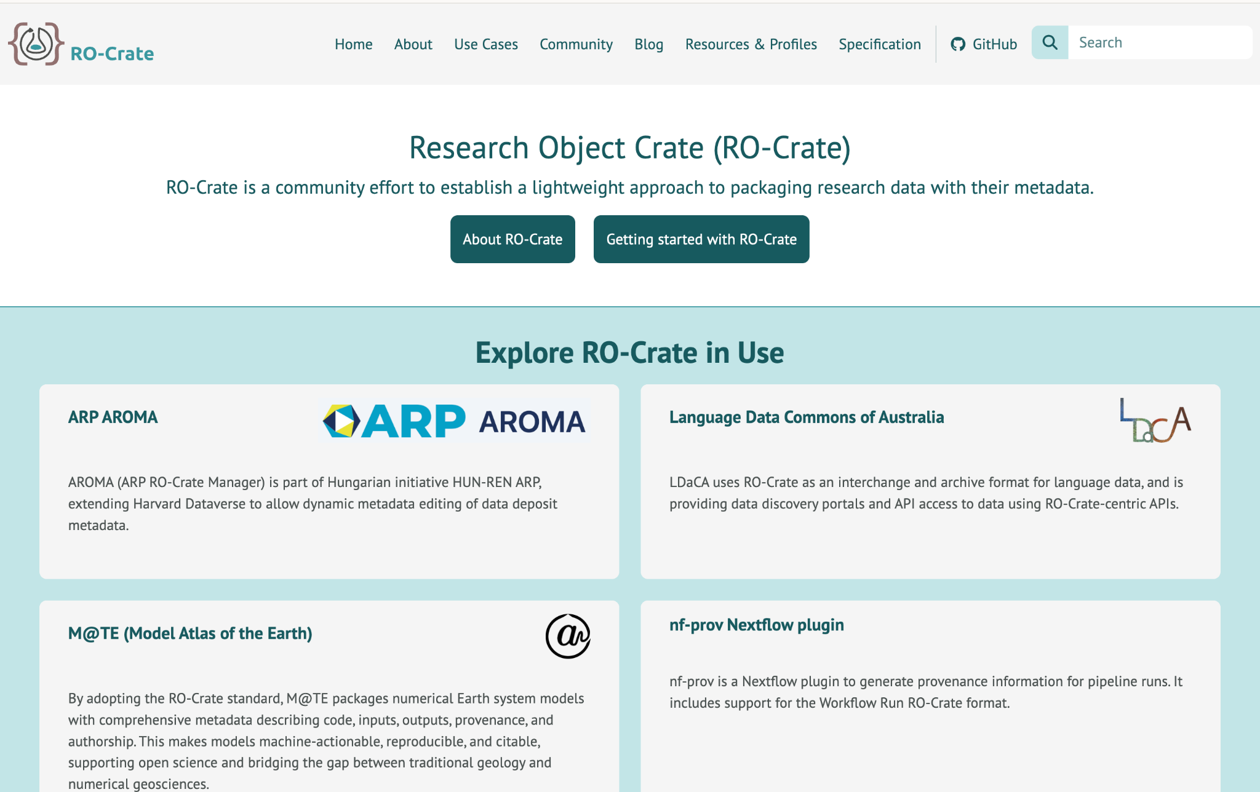
MASP NEXT STEPS
Establishing MASP under RO-Crate Steering Committee governance
More tools
  Example crates to MASP
  Legacy/existing linked data ontologies to MASP
  MASP editor app
Notes:
In terms of next steps, we aim to establish governance for MASP under the RO-Crate steering committee to ensure further support and interoperability with existing frameworks. MASP in on track to become an official RO-Crate specification.
We are also working on new tools to create and use MASPs, for example, creating new schemas and profiles by reading existing RO-Crate collections and inferring the structure, conversion of existing legacy linked data ontologies to RO-Crate, and an editor app to create and modify profiles and schemas.

Slide 18

Notes:
If you’d like to hear more about what LDaCA is working on, feel free to subscribe to our newsletter or get in contact with us.

